Slide 1



NETWORK INTRUSION DETECTION SYSTEM
BY INGRID MELIN, PATRYK KAISER AND DANIEL MACKEY

Slide 2
Introduction
We propose to develop a Network Intrusion Detection System (IDS).
We aim to implement this system using supervised machine learning (SML).
SML makes use of labeled data to help train an artificial intelligence (AI) which will classify network traffic based on features they share and detect potential cyber-attacks.

Slide 3
Our research shows that these are the most common types of attacks detected by an IDS:
Denial of Service (DoS)
TCP scan
UDP scan
SYN scan
ICMP scan
SSH/FTP bruteforce using dictionary
Our goal is to detect these common types of attacks.

Slide 4
Whats next?
Our system will log attacks that it detects.
We will develop a front-end website to display alerts and statistics on network activity.
Network administrators will get an overview of the network using visualizations of traffic, most common attacks detected, etc.

Slide 5
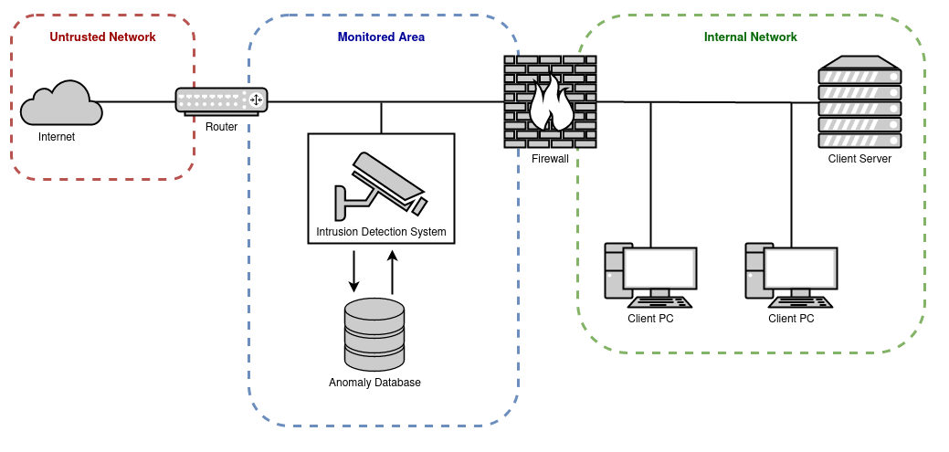

Slide 6
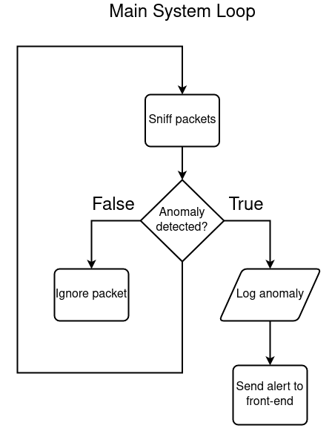

Slide 7
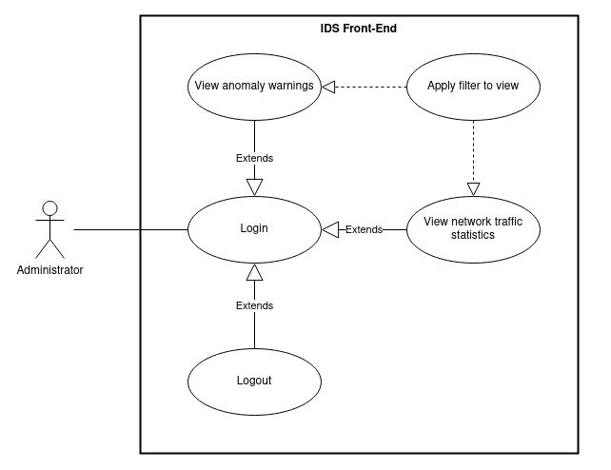

Slide 8
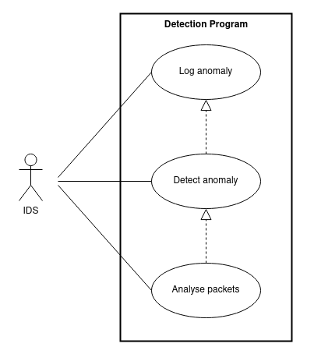

Slide 9
Designing and Building a Machine Learning Model
Software and modules we intend to use:
Python
SKLearn
Keras
Tensorflow
Wireshark, to test our model
Will be used to ultimately build the model

Slide 10
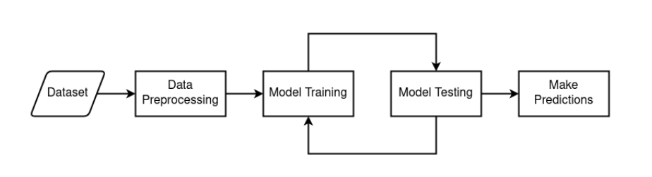
Architecture Design

Slide 11
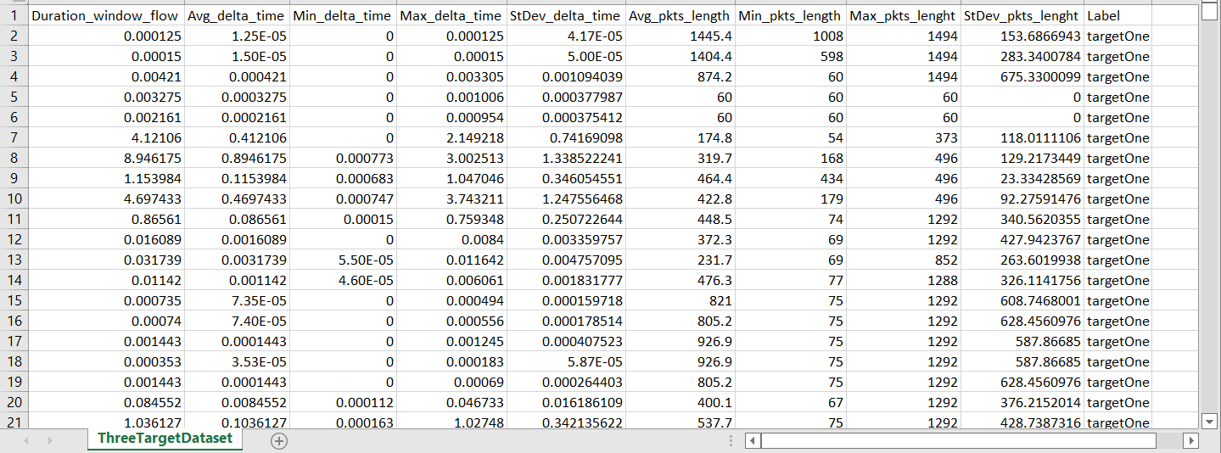
What might the dataset look like? “Dataset Format of Incoming Connections“ Using Wireshark and feature extractor

Slide 12
Format of our dataset
Packet signatures are very important and will teach our SML Program data patterns
Format above is sourced from Canadian Cybersecurity Institute Website
An example of a signature is Destination port, Flow Duration, Total Forward Packets
Mean, Standard Deviation and Z scores are heavily used in Normalization of feature vector patterns and comparing them

Slide 13
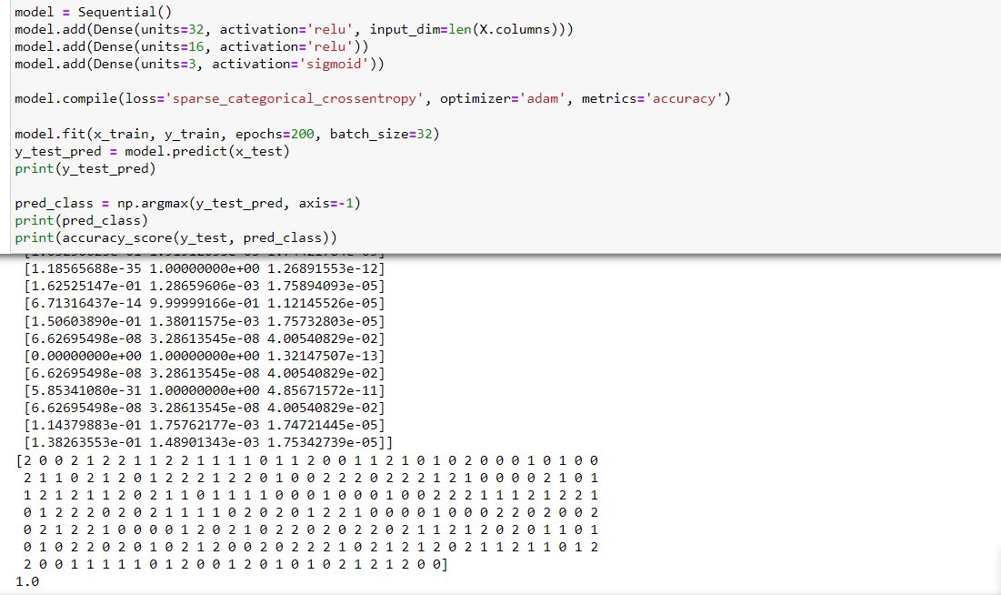
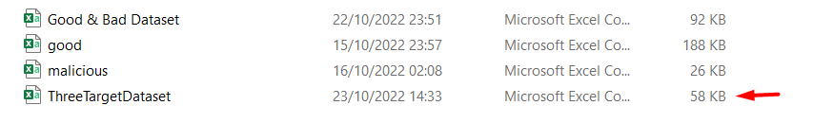
Proposed Technical Approach TensorFlow, Kera + SKLearn Machine Learning “Multi-Class Classification”

Slide 14
Measures of Success
Accuracy rating of 95%+ would be ideal
False positives are possibly unavoidable
No intention to impede traffic
System does not itself mitigate connection sources

Slide 15
Improving Accuracy
Tensorflow and its Keras Deep Learning Module enhance accuracy, while reducing loss
Larger datasets mean more knowledge
Variance of data parameters
Make training sets bigger
Avoid overfitting, prevent too much variance

Slide 16
AGILE METHODOLOGIES: SCRUM MEETINGS AND SPRINTS
We as a team have agreed to meet daily for 15 minutes, to discuss how we are progressing with the project.
The project manager keeps a record of each scrum meeting we have had.
Scrum questions:
What have you done to date?
What are you currently working on?
Do you have any problems/queries?
We go on a call once a week to touch base and to help each other out with the tasks

Slide 17
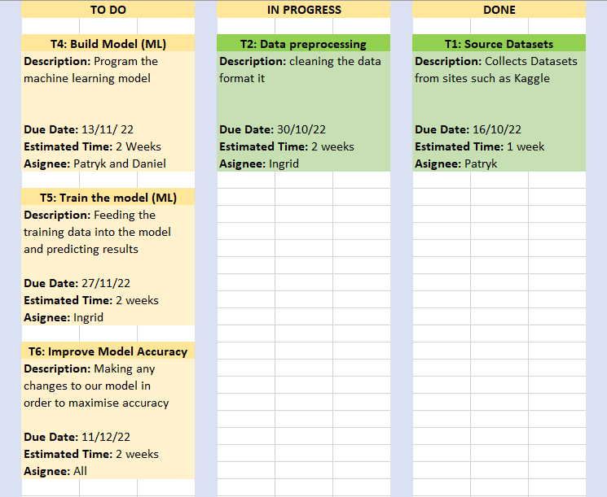
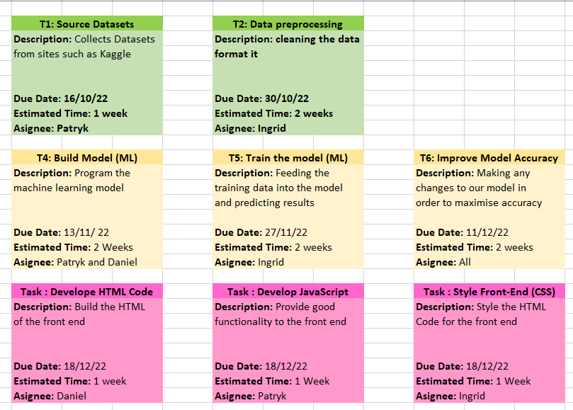
KANBAN BOARD
Our Kanban board allows us to keep a visual track of the status of our project tasks
We have broken the project down into manageable tasks and arranged them into sprints.
Tasks are lined up under the “To Do” column, and then are moved along the board until they are all under the “Done” column.
This project has three sprints. Each sprint into colour coded and put in order.

Slide 18
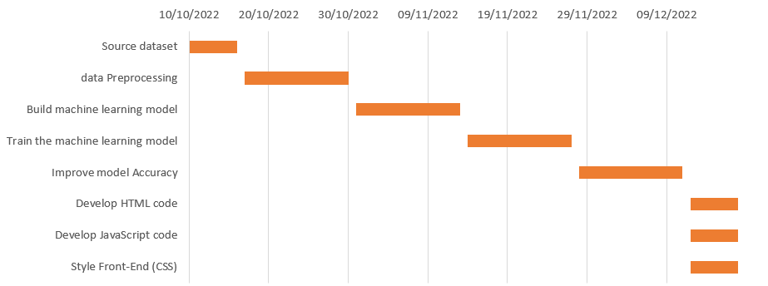
GANTT CHART
The Gantt chart provides an overall timeline for the project.
Each task is lined up along the edge and the relevant time slot that is associated with the task is placed next to it.

Slide 19
Thank you!
Any Questions?

